Slide 1
RISK Analysis and
MANAGEMENT
COMP6100001 - Software engineering
Session 14
Kenny Jingga, S.Kom., M.T.

Slide 2
Session 14 – risk Analysis and management
Learning objectives
At the end of this session, students will be expected to be able to:
Understand the definition of risks
Understand the risk management concepts and the proposed potential business project

Slide 3
Session 14 – RISK analysis and MANAGEMENT
Content outline
Risk definition
Reactive vs proactive strategies
Software risks
Risk identification
Risk assessment & prioritization
Risk mitigation & monitoring

Slide 4

Risk Definition
Risk
Risk a measure of the potential inability to achieve overall program objectives within defined cost, schedule, and technical constraints

Slide 5
Risk Definition
Two key components
Risk is defined by two key components:
The probability (or likelihood) of failing to achieve a particular outcome
The consequences (or impact) of failing to achieve that outcomes
Internal vs. External Risk
Internal: Risks that we can control
External: Risks that we cannot control

Slide 6
Reactive versus Proactive Risk Strategies
Reactive Risk Management
project team reacts to risks when they occur
mitigation—plan for additional resources in anticipation of fire fighting
fix on failure—resource are found and applied when the risk strikes
crisis management—failure does not respond to applied resources and project is in jeopardy

Slide 7
Reactive versus Proactive Risk Strategies
Proactive Risk Management
formal risk analysis is performed
organization corrects the root causes of risk
  TQM concepts and statistical SQA
  examining risk sources that lie beyond the bounds of the software
  developing the skill to manage change

Slide 8
Software risk
Seven Principles
Maintain a global perspective—view software risks within the context of system and the business problem
Take a forward-looking view—think about the risks that may arise in the future; establish contingency plans
Encourage open communication—if someone states a potential risk, don’t discount it.
Integrate—a consideration of risk must be integrated into the software process
Emphasize a continuous process—the team must be vigilant throughout the software process, modifying identified risks as more information is known and adding new ones as better insight is achieved.
Develop a shared product vision—if all stakeholders share the same vision of the software, it likely that better risk identification and assessment will occur.
Encourage teamwork—the talents, skills and knowledge of all stakeholder should be pooled

Slide 9
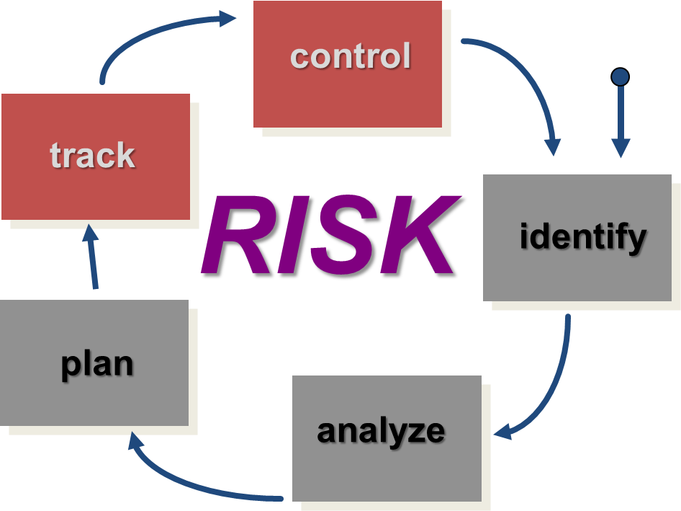
Software risk
Risk Management Paradigm

Slide 10
Software risk
Risk Identification
Product size —risks associated with the overall size of the software to be built or modified.
Business impact —risks associated with constraints imposed by management or the marketplace.
Customer characteristics —risks associated with the sophistication of the customer and the developer's ability to communicate with the customer in a timely manner.
Process definition —risks associated with the degree to which the software process has been defined and is followed by the development organization.
Development environment —risks associated with the availability and quality of the tools to be used to build the product.
Technology to be built —risks associated with the complexity of the system to be built and the "newness" of the technology that is packaged by the system.
Staff size and experience —risks associated with the overall technical and project experience of the software engineers who will do the work.

Slide 11
Software risk
Assessing Project Risk-I
Have top software and customer managers formally committed to support the project?
Are end-users enthusiastically committed to the project and the system/product to be built?
Are requirements fully understood by the software engineering team and their customers?
Have customers been involved fully in the definition of requirements?
Do end-users have realistic expectations?

Slide 12
Software risk
Assessing Project Risk-II
Is project scope stable?
Does the software engineering team have the right mix of skills?
Are project requirements stable?
Does the project team have experience with the technology to be implemented?
Is the number of people on the project team adequate to do the job?
Do all customer/user constituencies agree on the importance of the project and on the requirements for the system/product to be built?

Slide 13
Software risk
Levels of Risk Management
Crisis management: Fire fighting; address risks only after they have become problems.
Fix on failure: Detect and react to risks quickly, but only after they have occurred.
Risk mitigation: Plan ahead of time to provide resources to cover risks if they occur, but do nothing to eliminate them in the first place.
Prevention: Implement and execute a plan as part of the software project to identify risks and prevent them from becoming problems.
Elimination of root causes: Identify and eliminate factors that make it possible for risks to exist at all.

Slide 14
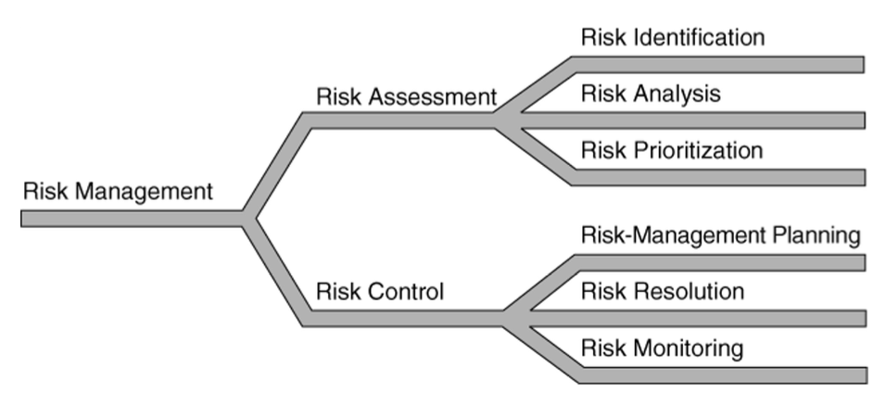
Software risk
Risk Management

Slide 15
Software risk
RISK COMPONENTs
performance risk—the degree of uncertainty that the product will meet its requirements and be fit for its intended use.
cost risk—the degree of uncertainty that the project budget will be maintained.
support risk—the degree of uncertainty that the resultant software will be easy to correct, adapt, and enhance.
schedule risk—the degree of uncertainty that the project schedule will be maintained and that the product will be delivered on time.

Slide 16
Software risk
Risk Projection
Risk projection, also called risk estimation, attempts to rate each risk in two ways
  the likelihood or probability that the risk is real
  the consequences of the problems associated with the risk, should it occur.
The are four risk projection steps:
  establish a scale that reflects the perceived likelihood of a risk
  delineate the consequences of the risk
  estimate the impact of the risk on the project and the product,
  note the overall accuracy of the risk projection so that there will be no misunderstandings.

Slide 17
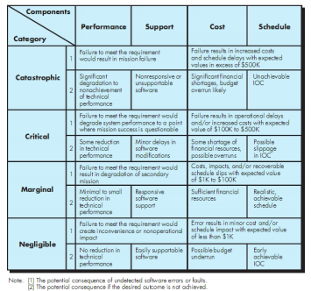
Software risk
Impact assessment

Slide 18
Software risk
Building the Risk Table
Estimate the probability of occurrence
Estimate the impact on the project on a scale of 1 to 4, where
  1 = catastrophic
  2 = critical
  3 = marginal
  4 = negligible
sort the table by probability and impact

Slide 19
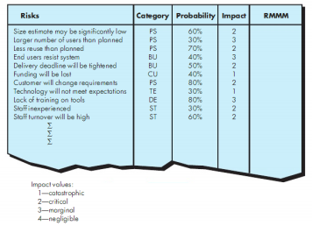
Software risk
Sample risk table prior to sorting

Slide 20
Software risk
Risk Exposure (Impact)
The overall risk exposure, RE, is determined using the following relationship [Hal98]:
RE = P x C
where
P is the probability of occurrence for a risk, and
C is the cost to the project should the risk occur.

Slide 21
Software risk
Risk Exposure Example
Risk identification. Only 70 percent of the software components scheduled for reuse will, in fact, be integrated into the application. The remaining functionality will have to be custom developed.
Risk probability. 80% (likely).
Risk impact. 60 reusable software components were planned. If only 70 percent can be used, 18 components would have to be developed from scratch (in addition to other custom software that has been scheduled for development). Since the average component is 100 LOC and local data indicate that the software engineering cost for each LOC is $14.00, the overall cost (impact) to develop the components would be 18 x 100 x 14 = $25,200.
Risk exposure. RE = 0.80 x 25,200 ~ $20,200.

Slide 22
Software risk
Risk Mitigation, Monitoring, and Management
Mitigation —how can we avoid the risk?
Monitoring —what factors can we track that will enable us to determine if the risk is becoming more or less likely?
Management —what contingency plans do we have if the risk becomes a reality?

Slide 23
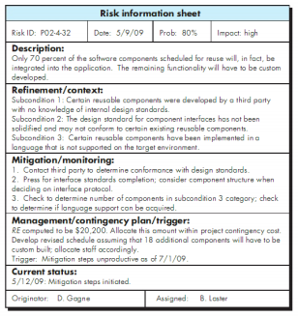
Software risk
RISK INFORMATION SHEET

Slide 24
Software risk
Observation
CI helps us catch errors before others see them
Probability a human makes a mistake: Very Likely
Severity: ranges, but could be extensive
Solution:
Use CI to catch your mistakes, make you look better, and mitigate your risks!

Slide 25
References
Roger Pressman and Bruce Maxim. (2020). Software Engineering: A Practitioner's Approach. 9th. McGraw Hill. New York. ISBN: 978- 1259872976.
Risk Management & operational Risk http://www.grafp.com/products/risk-manage.html

